Slide 1

Don’t bash powershell
Brian Bush
Sr Systems Administrator – UNIX Team
David Renfrow
Sr Systems Administrator – Windows Server Team

Slide 2
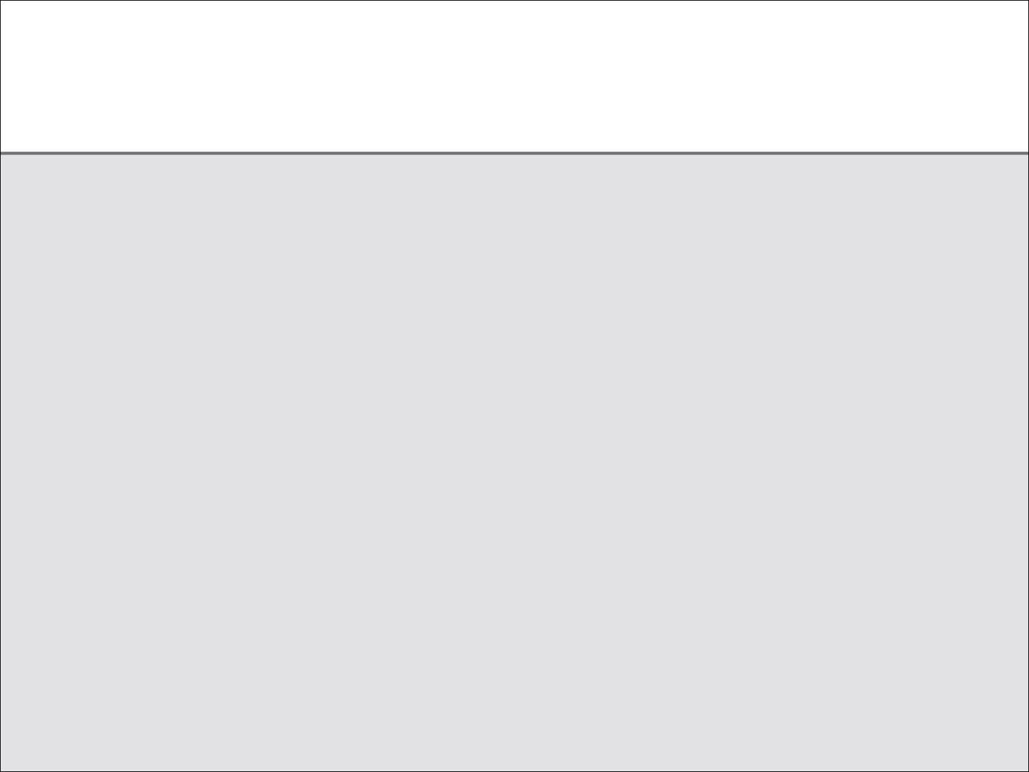
Managing Windows and Linux Firewalls with PowerShell
Security Scenario
PowerShell Scripting
Windows Configuration
Enable Firewall Logging
Firewall Log Formatting
Use the Log Object
Report Firewall Rules
Configuration Summary
Command Comparison
Linux Configuration
Import Module
Enable/Disable Logging
Read Firewall Log
Filter Firewall Log
Create Firewall Rules
Configuration Summary

Slide 3
Scenario
Active servers with disabled firewalls or enabled firewalls with unrestrictive rules need appropriate rules applied without impacting applications or services. This will be accomplished by:
Applying a firewall rule that will allow all inbound connections
Enabling the local software firewall
Enabling logging for all successful inbound connections
Parsing the firewall log to review and specify desired connections
Creating explicit rules to allow only specified connections
Removing the “allow all” inbound connection rule

Slide 4
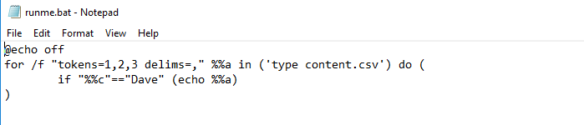
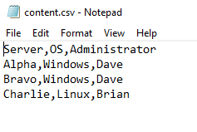
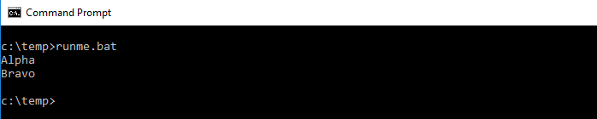
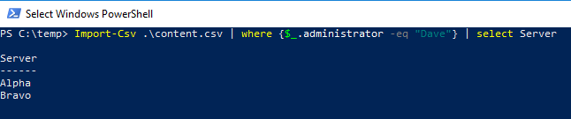
PowerShell Scripting

Slide 5
PowerShell Scripting
help about_Modules
Get-Module -ListAvailable
Get-Command -Module <ModuleName>
IE: Get-Command -Module NetSecurity
Get-Help <CmdletName> -Examples
IE: Get-Help New-NetFirewallRule -Examples

Slide 6
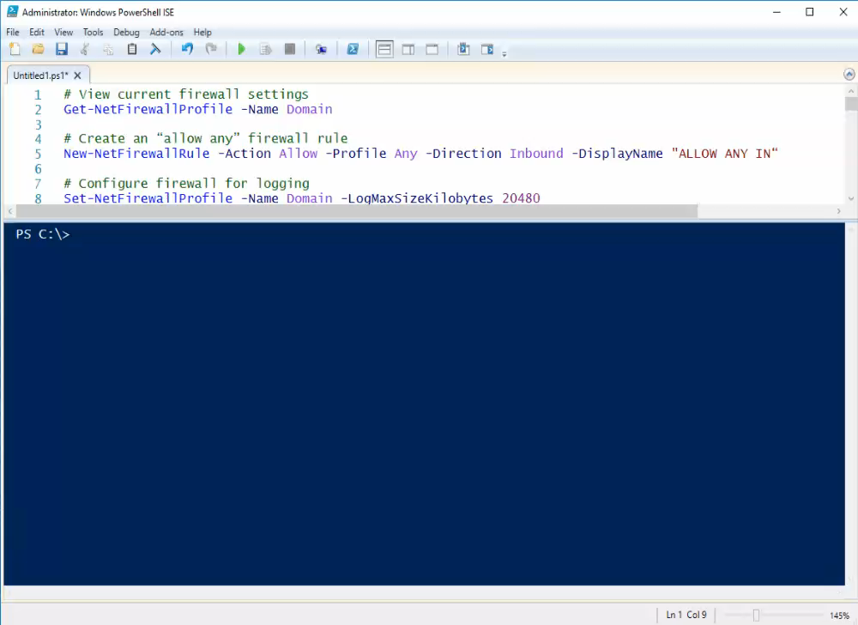
PowerShell Scripting

Slide 7
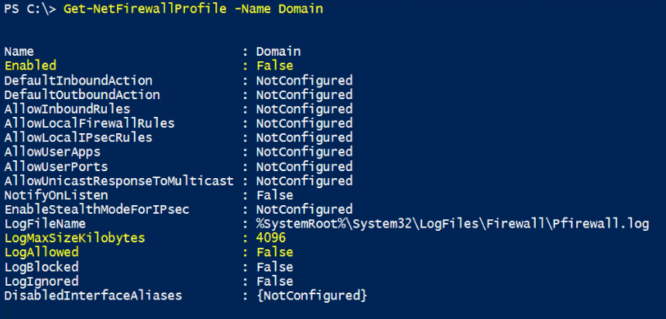
Enable Firewall Logging
Viewing Current Settings

Slide 8
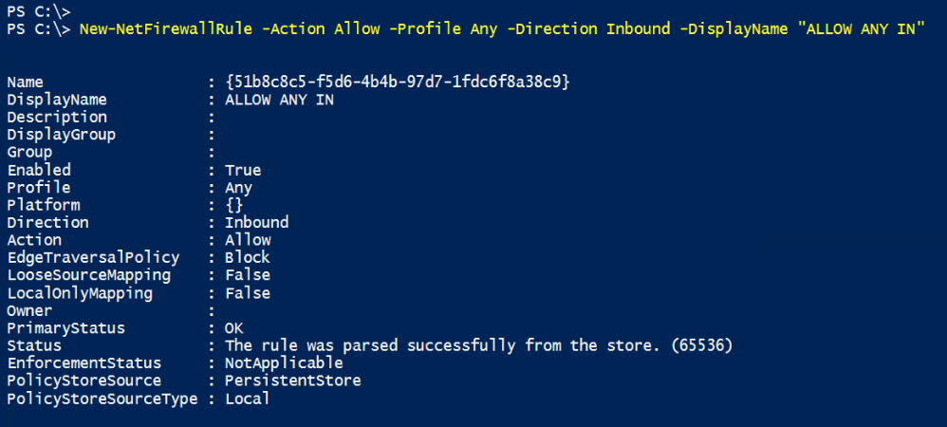
Enable Firewall Logging
Creating ‘Allow Any’ Rule

Slide 9
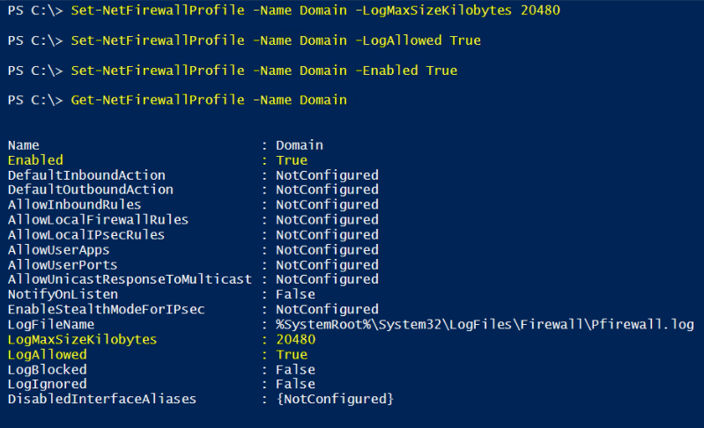
Enable Firewall Logging
Configuring and Verifying

Slide 10
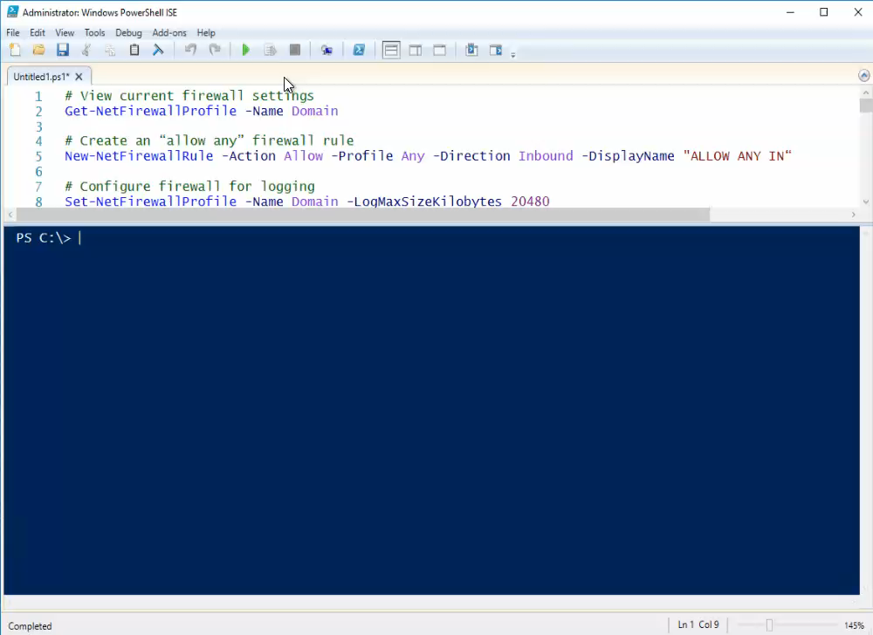
Enable Firewall Logging

Slide 11
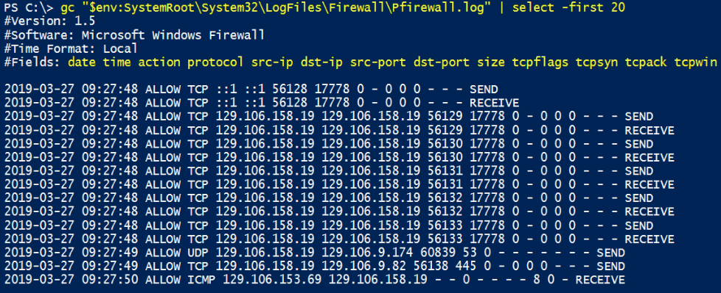
Firewall Log Formatting
Viewing the Default Log Format

Slide 12
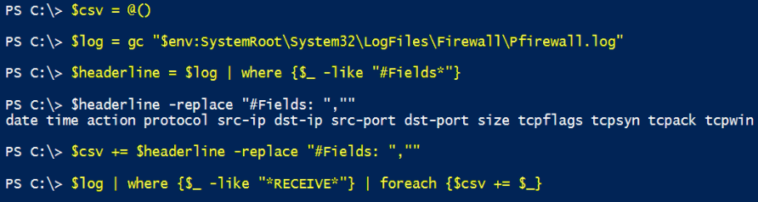
Firewall Log Formatting
Rewriting the Log

Slide 13
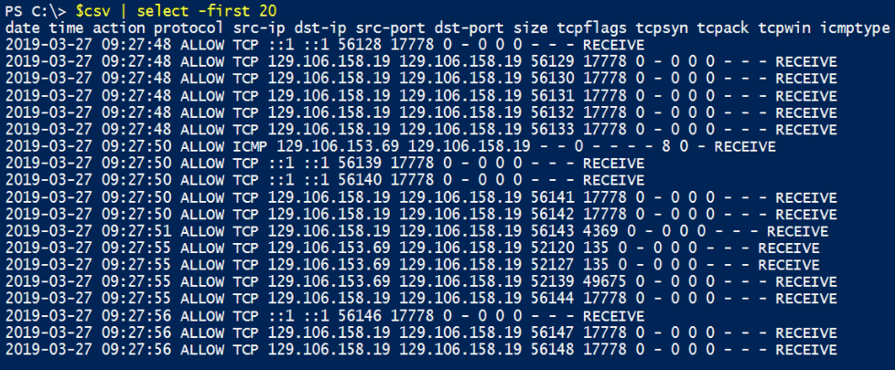
Firewall Log Formatting
Viewing the New Log

Slide 14
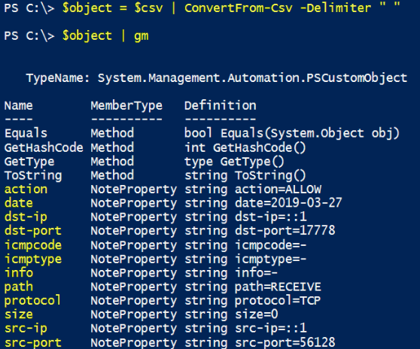
Firewall Log Formatting
Creating the Log Object

Slide 15
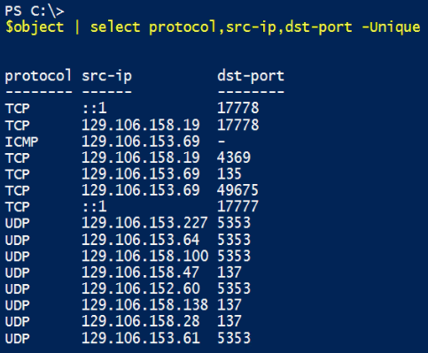
Firewall Log Formatting
Viewing the Log Object

Slide 16
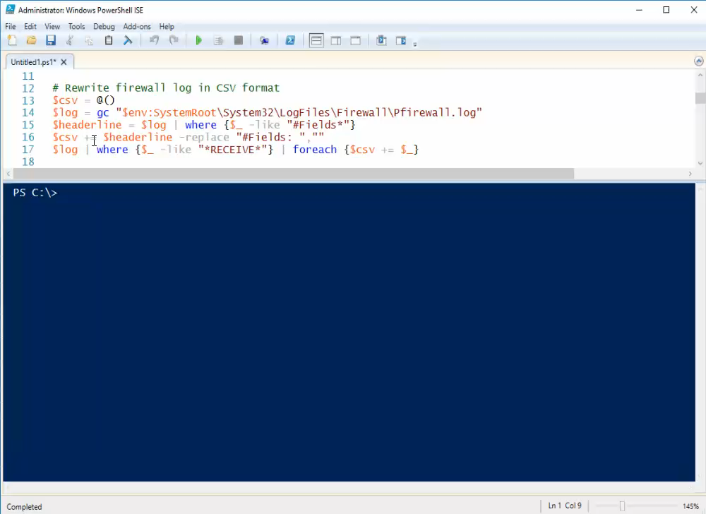
Firewall Log Formatting

Slide 17
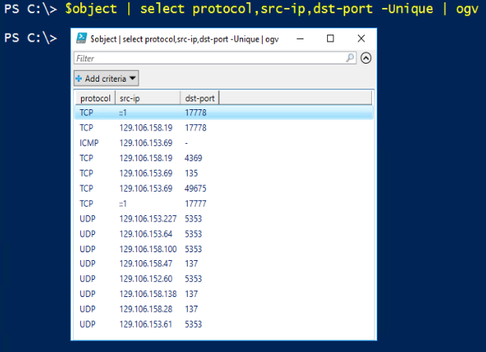
Use the Log Object
Viewing the Log with Grid-View

Slide 18
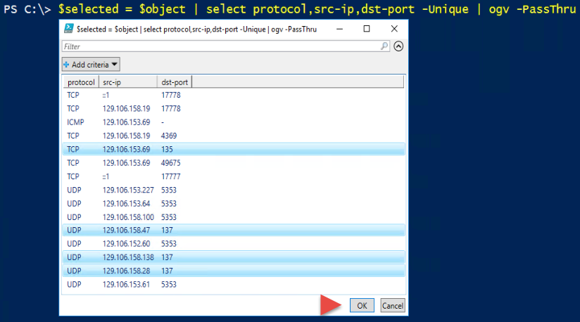
Use the Log Object
Passing Grid-View Selection

Slide 19
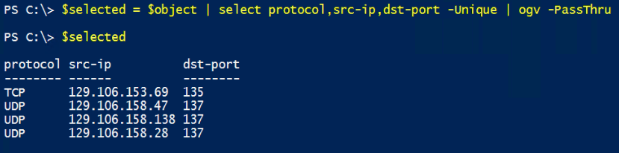
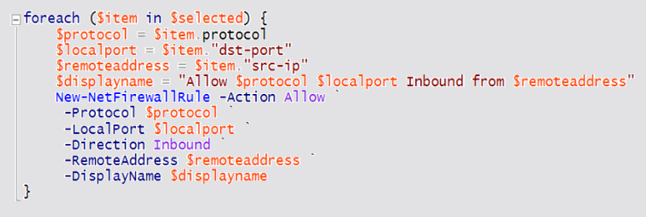
Use the Log Object
Creating Rules from Selection

Slide 20
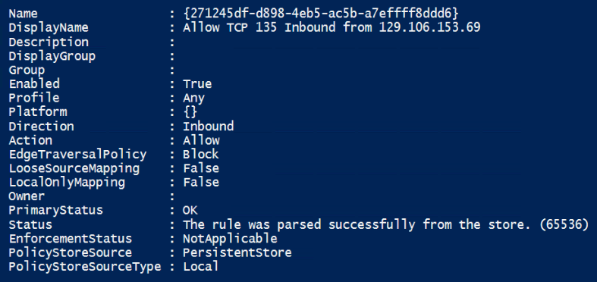
Use the Log Object
Creating Rules from Selection

Slide 21
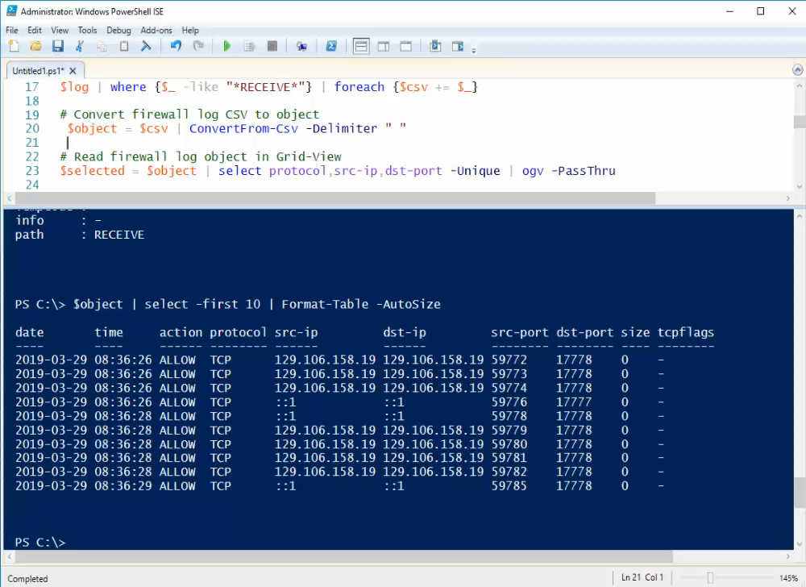
Use the Log Object

Slide 22
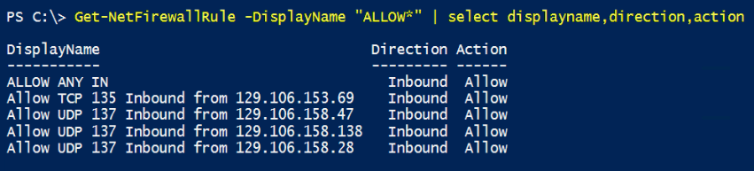
Report Firewall Rules
Viewing Base Rules

Slide 23
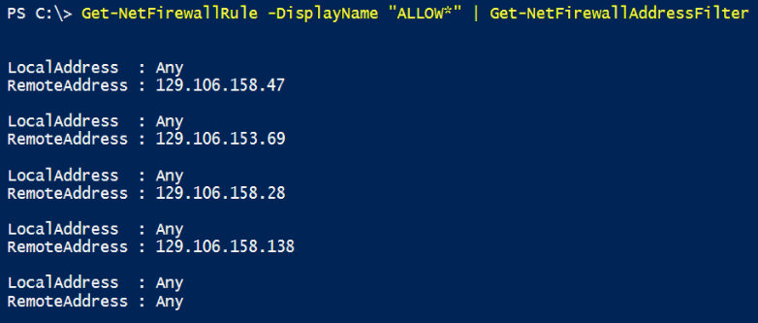
Report Firewall Rules
Viewing Address Filters

Slide 24
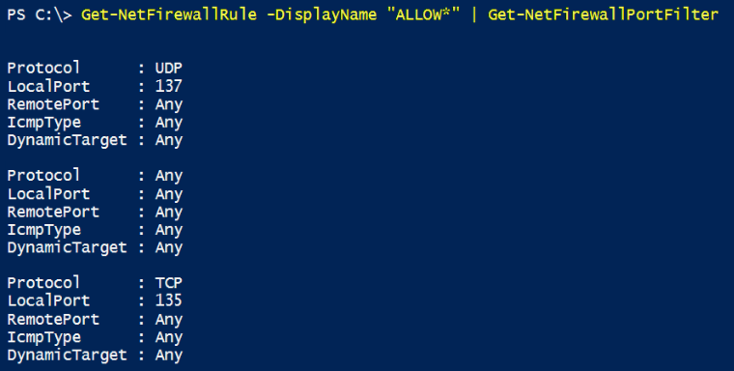
Report Firewall Rules
Viewing Port Filters

Slide 25
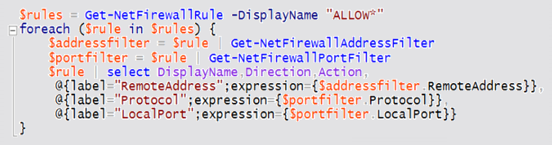
Report Firewall Rules
Combining Objects

Slide 26
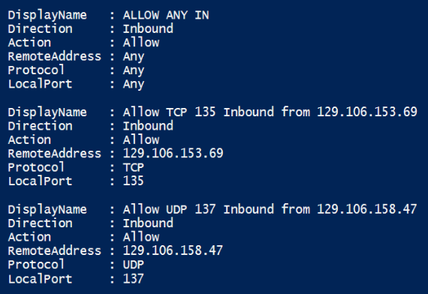
Report Firewall Rules
Combining Objects

Slide 27
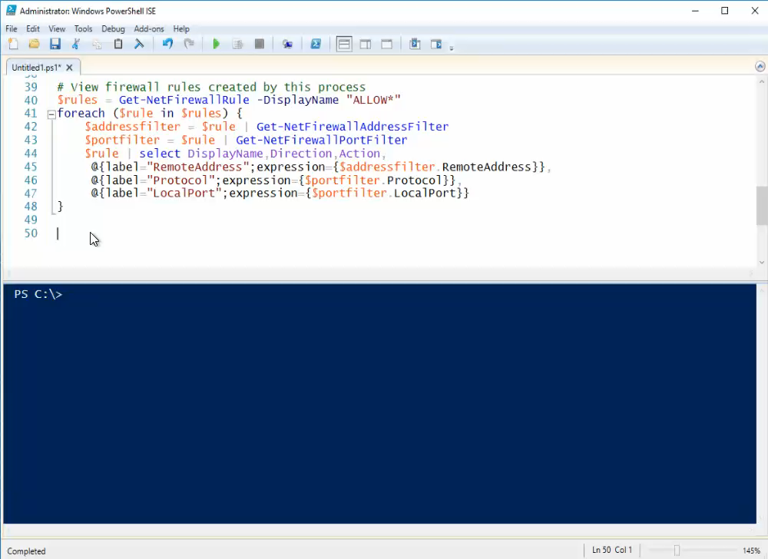
Report Firewall Rules

Slide 28
Configuration Summary
# View current firewall settings
Get-NetFirewallProfile -Name Domain
# Create an “allow any” firewall rule
New-NetFirewallRule -Action Allow -Profile Any -Direction Inbound -DisplayName "ALLOW ANY IN“
# Configure firewall for logging
Set-NetFirewallProfile -Name Domain -LogMaxSizeKilobytes 20480
Set-NetFirewallProfile -Name Domain -LogAllowed True
Set-NetFirewallProfile -Name Domain -Enabled True
# Rewrite firewall log in CSV format
$csv = @()
$log = gc "$env:SystemRoot\System32\LogFiles\Firewall\Pfirewall.log"
$headerline = $log | where {$_ -like "#Fields*"}
$csv += $headerline -replace "#Fields: ",""
$log | where {$_ -like "*RECEIVE*"} | foreach {$csv += $_}
# Convert firewall log CSV to object
$object = $csv | ConvertFrom-Csv -Delimiter " "
# Read firewall log object in Grid-View
$selected = $object | select protocol,src-ip,dst-port -Unique | ogv -PassThru
# Create a firewall rule for each Grid-View selection
foreach ($item in $selected) {
$protocol = $item.protocol
$localport = $item."dst-port"
$remoteaddress = $item."src-ip"
$displayname = "Allow $protocol $localport Inbound from $remoteaddress"
New-NetFirewallRule -Action Allow `
-Protocol $protocol `
-LocalPort $localport `
-Direction Inbound `
-RemoteAddress $remoteaddress `
-DisplayName $displayname
}
# View firewall rules created by this process
function get-allfirewallrules ($name) {
$rules = Get-NetFirewallRule -DisplayName "$name"
foreach ($rule in $rules) {
$addressfilter = $rule | Get-NetFirewallAddressFilter
$portfilter = $rule | Get-NetFirewallPortFilter
$rule | select DisplayName,Direction,Action,
@{label="RemoteAddress";expression={$addressfilter.RemoteAddress}},
@{label="Protocol";expression={$portfilter.Protocol}},
@{label="LocalPort";expression={$portfilter.LocalPort}}
}
}
Powershell Cmdlets/Functions Used

Slide 29
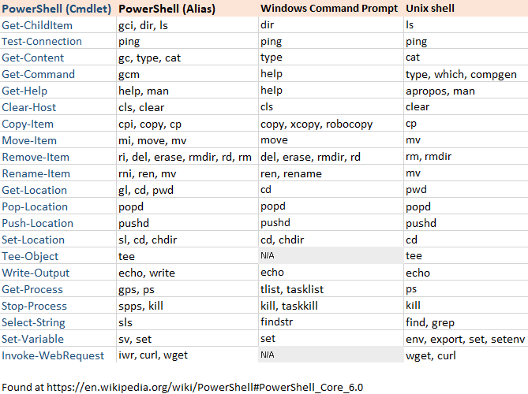
Command Comparison

Slide 30
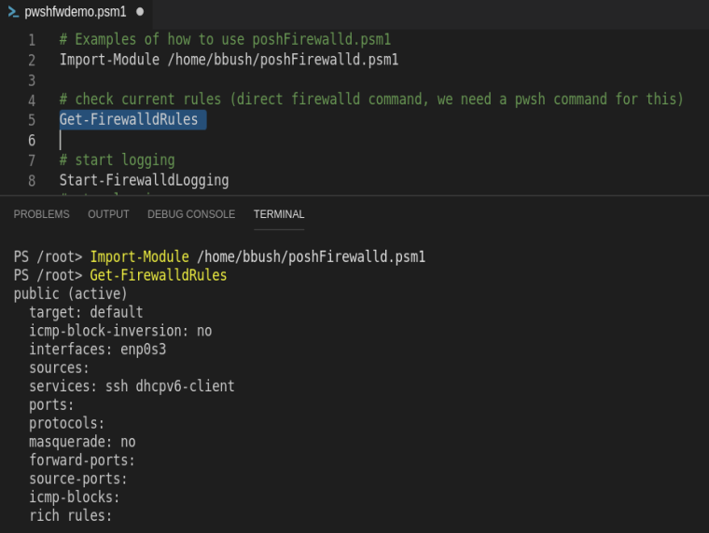
Import Module
Download, Import, Read Rules

Slide 31
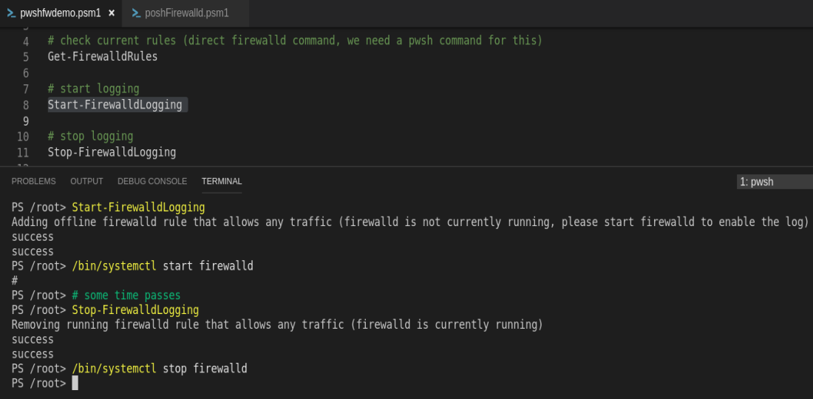
Enable/Disable Logging
Starting and Stopping the Log

Slide 32
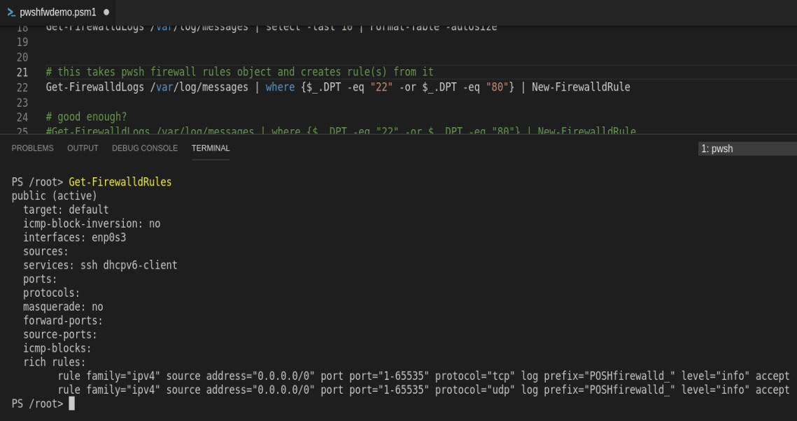
Enable/Disable Logging
Verifying the Logging Configuration

Slide 33
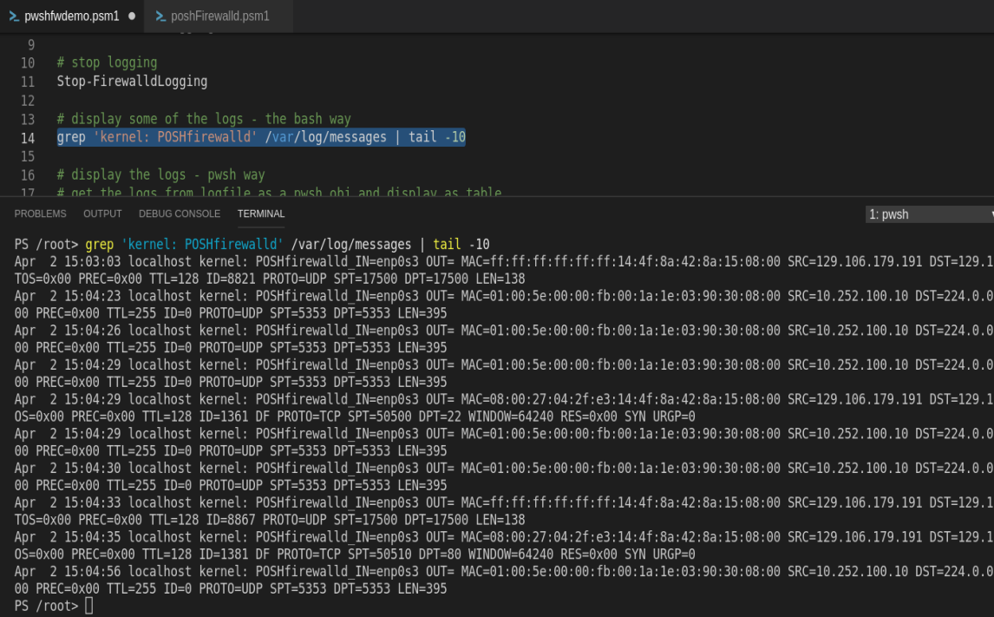
Read Firewall Log
Viewing the Log Contents via BASH

Slide 34
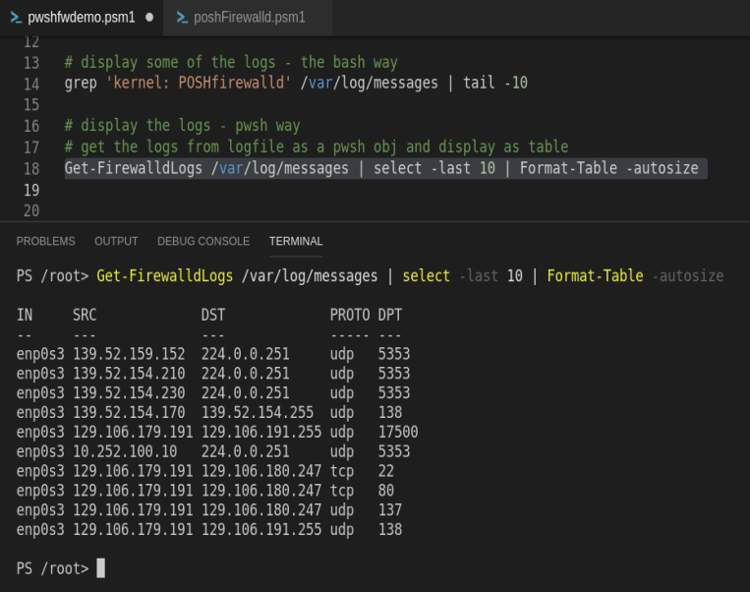
Read Firewall Log
Converting the Log to an Object in POSH

Slide 35
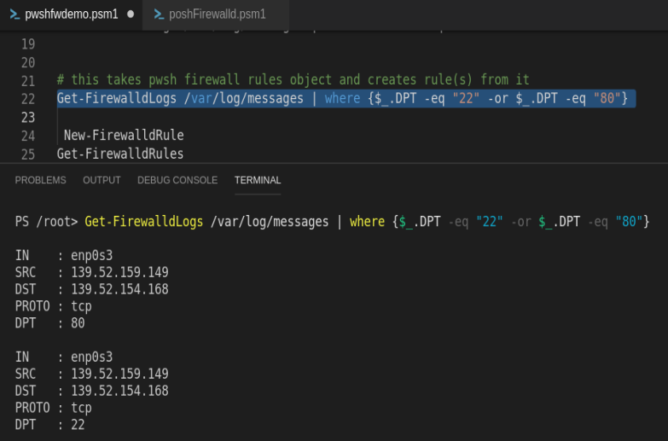
Filter Firewall Log
Using Where to Filter the Log Object

Slide 36
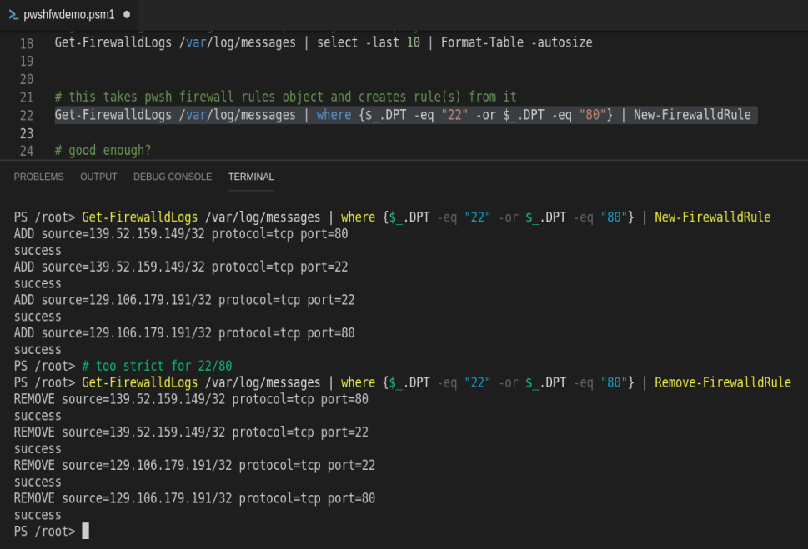
Create Firewall Rules
Adding/Removing Rules from the Log

Slide 37
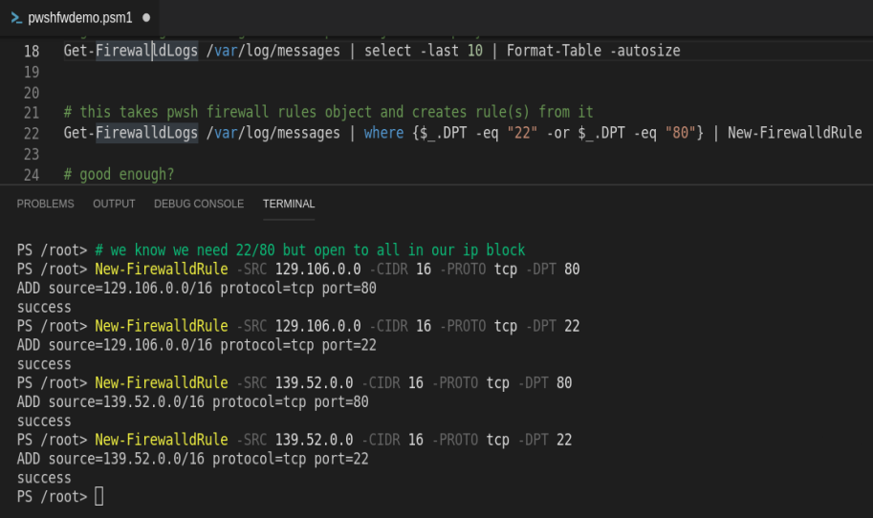
Create Firewall Rules
Adding Network Range Rules Manually

Slide 38
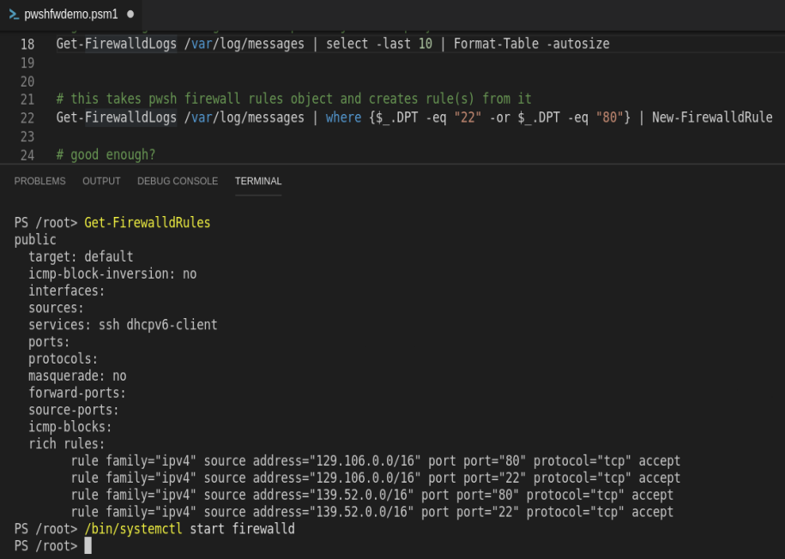
Report Firewall Rules
Verifying the Configuration

Slide 39
Configuration Summary
# acquire the module
https://github.com/uthdcos/poshFirewalld
# import the module
Import-Module /home/directory/poshFirewalld.psm1
# check current rules
Get-FirewalldRules
# start logging
Start-FirewalldLogging
# stop logging after desired traffic has been generated
Stop-FirewalldLogging
# display sample of log data
grep ‘kernel: POSHfirewalld’ /var/log/messages | tail -10
# display the log object through PowerShell
Get-FirewalldLogs /var/log/messages | select -last 10 | Format-Table -autosize
# filter firewall log object for SSH and HTTP only; create rules from results
Get-FirewalldLogs /var/log/messages | where {$_.DPT -eq “22” -or $_.DPT -eq “80”} | New-FirewalldRule
# remove the same rules created above
Get-FirewalldLogs /var/log/messages | where {$_.DPT -eq “22” -or $_.DPT -eq “80”} | Remove-FirewalldRule
# create manual firewall entries specifying a range with CIDR
New-FirewalldRule -SRC 129.106.0.0 -CIDR 16 -PROTO tcp -DPT 80
New-FirewalldRule -SRC 129.106.0.0 -CIDR 16 -PROTO tcp -DPT 22
New-FirewalldRule -SRC 139.52.0.0 -CIDR 16 -PROTO tcp -DPT 80
New-FirewalldRule -SRC 139.52.0.0 -CIDR 16 -PROTO tcp -DPT 22
Powershell Cmdlets/Functions Used

Slide 40
Q & A
PowerShell Firewalld Module on GitHub
https://github.com/uthdcos/poshFirewalld
Brian Bush
brian.m.bush@uth.tmc.edu
David Renfrow
david.m.renfrow@uth.tmc.edu

